Slide 1


J.S.H. Packagings
(An ISO 9001-2008 Company)
www.jshpackagings.com

Slide 2

MANAGEMENT PROFILE
Mr. Vineet Maheshwari
B.Com. (Hons), FCA
Business Partners
Mr. Minoo Agaraiya
B.Com. (Hons), FCA
Business Partners
JSH Packagings was established & promoted in Oct 1998 by both the partners and by qualification both are Chartered Accountants.
Mr. Vineet K Maheshwari is controlling new developments & manufacturing division whereas Mr. Minoo Agaraiya is controlling finances & Accounts.

Slide 3

OVERVIEW
M/S JSH Packagings is a complete Packaging solution provider company started its first manufacturing unit at Noida, UP in Oct 1998 now we are fascilating in PAN INDIA.
VISION
“ Most admired by our customer, employees, business partners & suppliers for the experience & value they enjoy from being with us "
MISSION
“ To exceed our customers needs and expectations by providing the highest level of service through a team approach of innovative design solutions and superior quality packaging products "

Slide 4
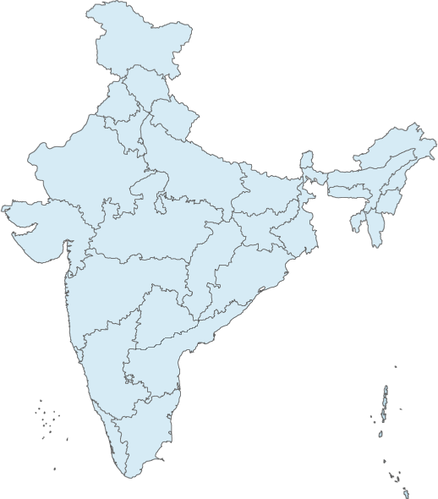
MANUFACTURING PLANTS
HARIDWAR
NOIDA
BAWAL
Rewari
PUNE
Manufacturing Plant
New Facility
CHEENAI

Slide 5
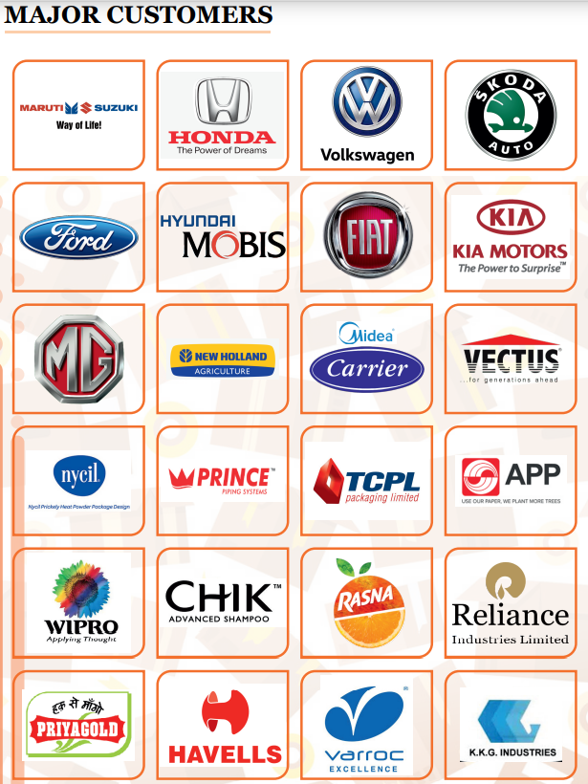




Slide 6
















Slide 7

ABOUT US
Types of Products
Category 1 : Corrugated Boxes
JSH Packaging is a ISO 9001:2000 Complete Packaging Solution Provider company.
The company is in to the area of complete Packaging business solution with a state of state-of-the art technology with global know how & advanced equipment. Operating now through 4 plants, the company have around 2 Lacs SQF area & a 800+ workforce, catering around More than 24 leading clients supporting their domestic & Exports business.
It’s current installed capacity is to manufacture 100 tones per day which is to be ramped up around double by 2025-2026.
Apart from corrugated boxes, it is also into all types of Wooden boxes, pallets & offers Complete Palletized packing Solution to many prestigious clients across the count

Slide 8
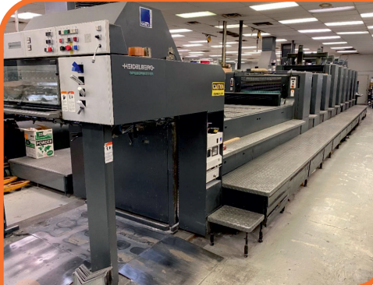
Category 2 : Mono Offset Cartons
As providing a complete packaging solution we JSH PACKAGINGS are also the manufacturers of mono cartons catering automobile customers, pharmaceuticals , FMCGs and many more.
We are the providing the mono offset cartons having 6 colour printing with UV Varnishing and embossing as required by the customer.
We have build up a facility to provide:
Multi Colour Hi – Class printed sheets and mono cartons with offset printing press.

Slide 9
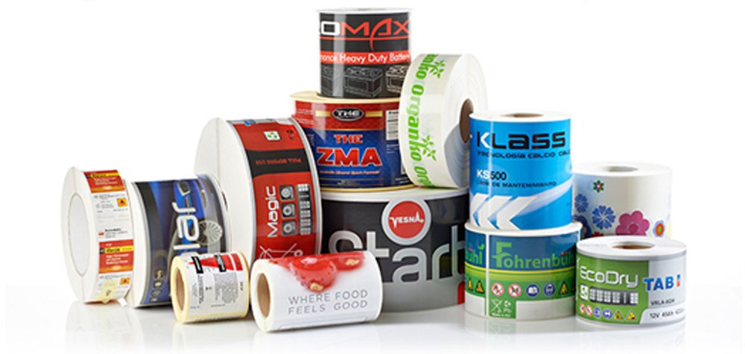
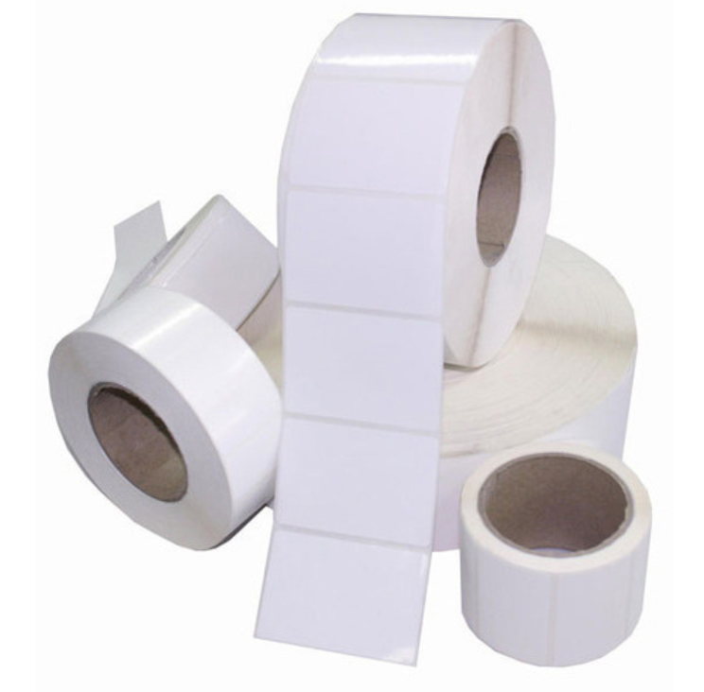
Category 3 :Printed Labels
As providing a complete packaging solution we JSH PACKAGINGS are also the manufacturers of Labels/Stickers catering automobile customers , pharmaceuticals and FMCGs.
The company has the capacity to produce 80,000 mtr per day with Automatic Printing Machine.
Apart from manufacturing of label stickers the company is also involved in manufacturing of Industrial Tapes for packaging , cores , Wax resin and polythene bag.

Slide 10
Category 4 :EPE FOAMS
As providing a complete packaging solution we JSH PACKAGINGS are also the manufacturers of EPE FOAMS ( Customised as per Customer Demand)
Currently our major customer is Reliance Jio ( Used for Antenna Routers ) and our other customers for EPE FOAM are follows
Volkswagen Group
JCB INDIA LIMITED
CNH INDUSTRIES
JIO ( Reliance )
EICHER INDIA LIMITED

Slide 11
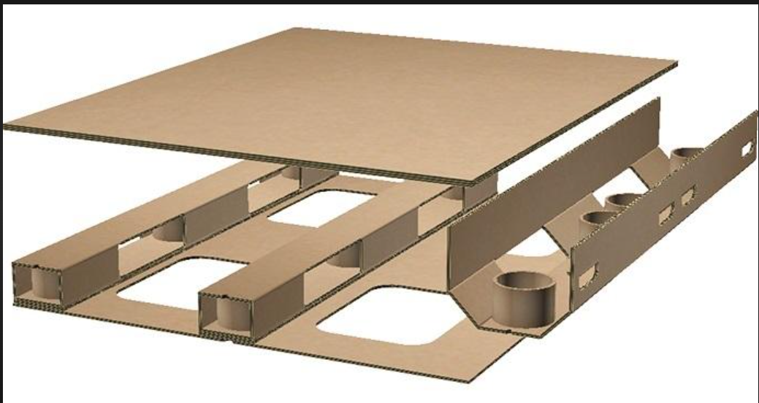
CORRUGATED PALLETS
CORRUGATED PALLET FOR PACKAGING
WE JSH PACKAGINGS HAVE INTRODUCED THE CORRUGATED PALLET WHICH WOULD REPLACE THE WOODEN PALLET / METAL PALLET FOR DOMESTIC AND EXPORT PURPOSE
WITH THE MIXTURE OF ANGLE BOARD AND CORRUGATED SHEETS WE HAVE DEVELOPED A PALLET WHICH COULD SUSTAIN UPTO 1500KGS DEPENDING ON THE REQUIREMENT

Slide 12
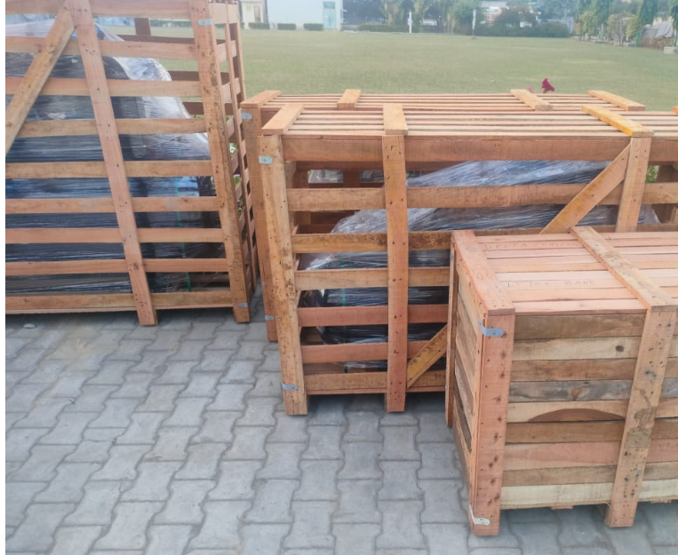
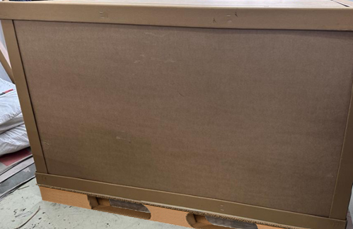
REASON FOR CHANGE
With the revolution of time , we are changing the concept of Wooden Packaging which would reduce the Wood Consumption to 90% in the Packaging.
Due to high rise of Carbon Footprints we need to stop the usage of Wooden Packaging and shift towards Corrugated / Angle Board Packaging.
The Corrugated/ Angle Board Packaging can be recycled upto 17 TIMES.
With Corrugated Pallettized Packaging we can also provide Branding and Printing on the Outer side of the Box
It also improves the Packaging Standards and Quality of Packaging for the Industry

Slide 13
REASON FOR CHANGE – COST SAVINGS
One of the reason for the change is also that it will also be more economical than the Wooden Packaging
A cost saving of 10-15% can be done from shifting to Corrugated Packaging from the Wooden Packagings.

Slide 14

PLANT CAPACITY UNIT WISE (2024-25)

Slide 15
PLANT CAPACITY For Corrugation
PROJECTED PLANT CAPACITY

Slide 16
ANNUAL SALES JSH GROUP

Slide 17

NEW PROJECT - IMT BAWAL REWARI
We JSH PACKAGINGS would be in a position by April 2025 to commence the Production of our New Corrugated Line which would be one of the Biggest Automatic Plant In India
With the upgradation of the Technology our new Plant would be Fully Automated and we would be achieving reduction in the Manpower by 40%
The Plant would be setup in IMT BAWAL , REWARI and we would be serving PAN INDIA from that Plant

Slide 18


Strength Of JSH
Trusted supplier of top automotive OEM’s, FMCG & automobile ancillaries.
All materials supplied on JIT basis.
Achieved Reduced packing time at customer end by supplying ready to place inners.

Slide 19


Corporate Office & Unit-I
F-128, Sec-VIII, Noida-201301 (U.P.) Tel 0120-4206101 Fax : 4315559
Unit - II (Hardwar):Plot No. 47-48, SEC-V, I.I.E., Ranipur, SIDCUL, Hardwar (Uttarakhand)
Unit-III (Bawal):Plot no. 60, Phase 11 , HARYANA Sector – 14, IMT BAWAL, Haryana
Unit -IV ( Chennai):JH PACKAGINGS PRIVATE LTD. A-11,PILIIAPAKKAM INDUSTRIAL AREA SRIPERUMUDUR,
CHENNAI
Unit – V (Pune):Shed No. 1 Grampanchayat Milkat no 1115 Mahalunkar INDS Gate No. 201 Pune - 410501
Unit – VI (Bawal Unit 2):PLOT NO 12 SECTOR-9 IMT BAWAL DISTT REWARI (HARYANA)
Contact Persons :
Vineet Maheshwari , +9810131014 , vineetmaheshwari@jshpackagings.com
Minoo Agaraiya , +9818144024 , minooagaraiya@jshpackagings.com
Ayush Agaraiya , +9717599456, ayush@jshpackagings.com
Daksh Maheshwari, +9990698236 , dakshmaheshwari@jshpackagings.com
www.jshpackagings.com

